Slide 1
Databases and Application Programs

Slide 2
Goals
To review and understand how relational databases store information
To learn how to query a database with the Structured Query Language (SQL)
To connect to databases with Java Database Connectivity (JDBC)
To write database programs that insert, update, and query data in a relational database

Slide 3
Organizing Database Information
Relational database
  Stores information in tables
  Each table column has a name and data type

Slide 4
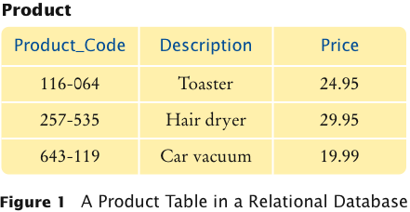
Product Table in a Relational Database

Slide 5
SQL
SQL stands for Structured Query Language
SQL is a command language for interacting with databases
Most relational databases follow the SQL standard
SQL is not case sensitive:
  "create table" is the same as "CREATE TABLE"
We will use uppercase letters for SQL keywords and mixed case for table and column names

Slide 6
Some SQL Types and Their Corresponding Java Types
SQL Data Type | Java Data Type
INTEGER or INT | int
REAL | float
DOUBLE | double
DECIMAL(m, n) | Fixed-point decimal numbers with m total digits and n digits after the decimal point; similar to BigDecimal.
BOOLEAN | Boolean
VARCHAR(n) | Variable-length String of length up to n
CHARACTER(n) or CHAR(n) | Fixed-length String of length n

Slide 7
SQL Command to Create a Table
CREATE TABLE Product
(
Product_Code CHAR(11),
Description CHAR(40),
Price DECIMAL(10, 2)
)

Slide 8
SQL Command to Add Data to a Database
Use the INSERT INTO command to insert rows into the table
Issue one command for each row, such as
  INSERT INTO Product
  VALUES ('257-535', 'Hair dryer', 29.95)

Slide 9
SQL
SQL uses single quotes ('), not double quotes, to delimit strings
What if you have a string that contains a single quote?
  Write the single quote twice:
    'Sam''s Small Appliances'
To remove an existing table use the DROP TABLE command:
  DROP TABLE Test

Slide 10
A Customer Table
Consider a Java class Customer:
  public class Customer
  {
  ...
  private String name;
  private String address;
  private String city;
  private String state;
  private String zip;
  }
It is simple to come up with a database table structure that allows you to store customers

Slide 11
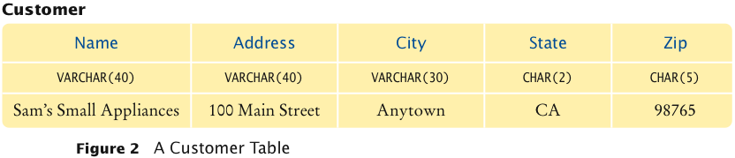
A Customer Table

Slide 12
An Invoice Table
For other objects, it is not so easy to come up with an equivalent database table structure
Consider an invoice; each invoice object contains a reference to a customer object:
    public class Invoice
    {
    ...
    private int invoiceNumber;
    private Customer theCustomer;
    ...
    }

Slide 13
An Invoice Table
You might consider simply entering all the customer data into the invoice tables
  It is wasteful
  It is dangerous; on a change, you can forget to update all occurrences
In a Java program, neither of these problems occur
  Multiple Invoice objects can contain references to a single Customer

Slide 14
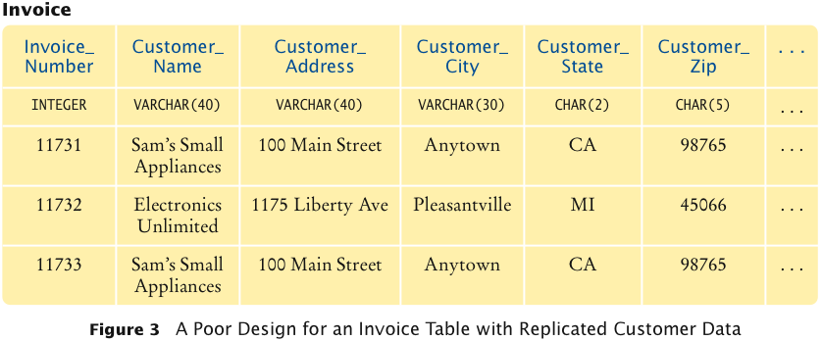
Poor Design for an Invoice Table with Replicated Customer Data

Slide 15
Linking Tables
Replicating the same data in multiple rows has two problems
It is wasteful to store the same information multiple times
If the data needs to change it has to be changed in multiple places
Instead you should distribute the data over multiple tables

Slide 16
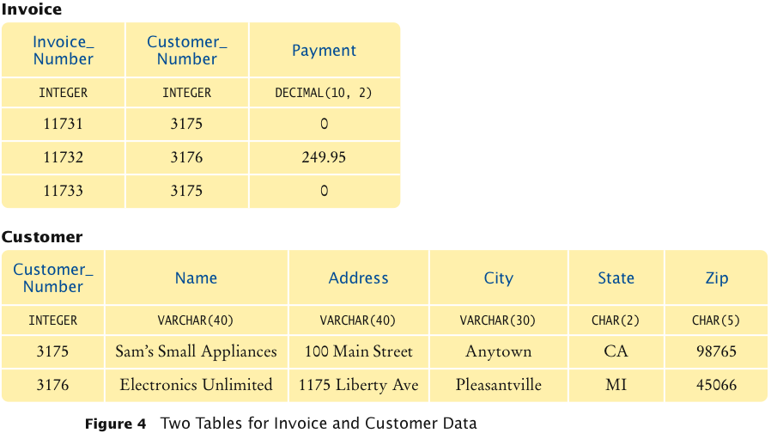
Two Tables for Invoice and Customer Data

Slide 17
Linking Tables
In the table above, customer data are not replicated
Customer table contains a single record for each customer
Invoice table has no customer data
The two tables are linked by the Customer_Number field
The customer number is a unique identifier
  We introduced the customer number because the customer name by itself may not be unique

Slide 18
Primary Keys
Primary key is a column (or combination of columns) whose value uniquely specifies a table record
Not all database tables need a primary key
You need a primary key if you want to establish a link from another table
Foreign key is a reference to a primary key in a linked table
Foreign keys need not be unique

Slide 19
Implementing Multi-Valued Relationships
Each invoice may have many line items
Do not replicate columns, one for each line item
Do distribute the information in two tables, invoice and line item
Link each line item to its invoice with an Invoice_Number foreign key in the line item table

Slide 20
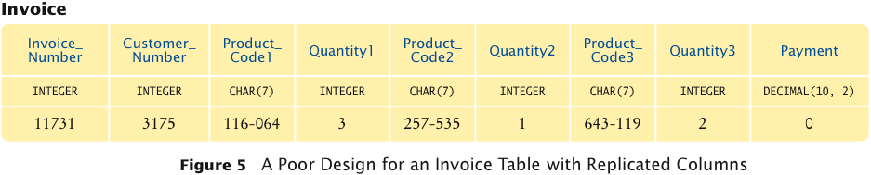
Poor Design for Invoice Table with Replicated Columns

Slide 21
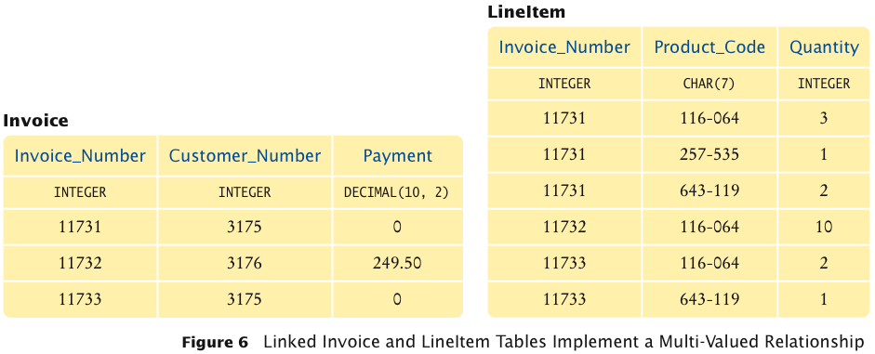
Linked Invoice and LineItem Tables

Slide 22
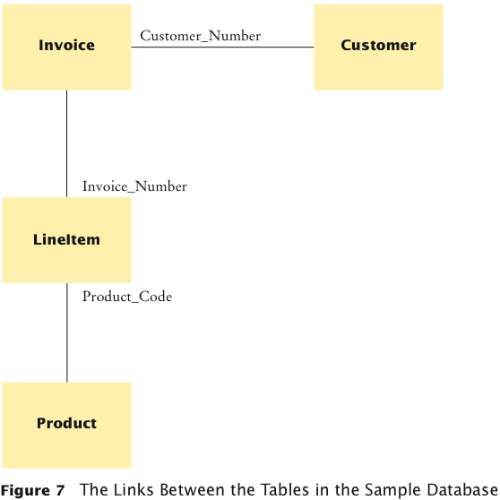
Sample Database

Slide 23
Queries
Once the database is constructed, we can query it for information
  What are the names and addresses of all customers?
  What are the names and addresses of all customers in California?
  What are the names and addresses of all customers who buy toasters?
  What are the names and addresses of all customers with unpaid invoices?

Slide 24
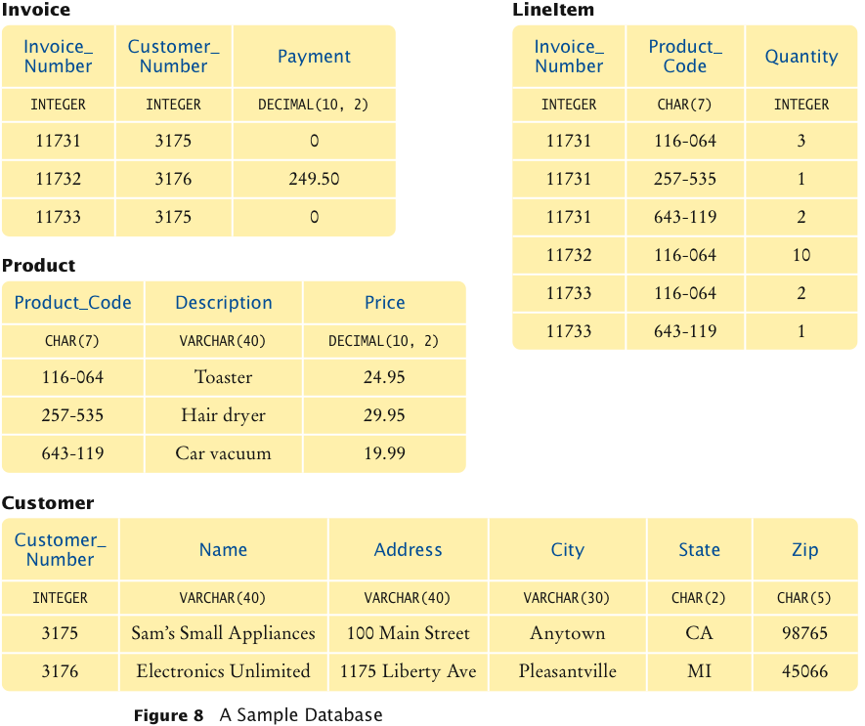
A Sample Database

Slide 25
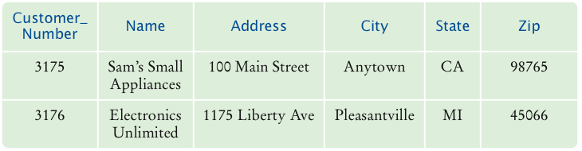
Simple Query
Use the SQL SELECT statement to query a database
The query to select all data from the Customer table:
  SELECT * FROM customer
The outcome of a query is a view:
A view is a “window” through which you can see some of the database

Slide 26
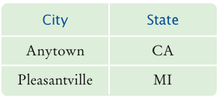
Selecting Columns
You may want to view only some of the columns in the table
Query to select the city and state of all customers from the Customer table:
  SELECT City, State FROM Customer

Slide 27
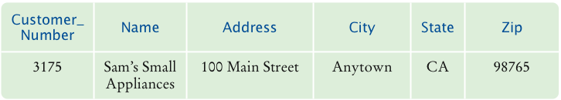
Selecting Subsets
You can select rows that fit a particular criteria
When you want to select a subset , use the WHERE clause
Query to find all customers in California:
  SELECT * FROM Customer WHERE State = 'CA'
Query to select all customers NOT in California:
  SELECT * FROM Customer WHERE State <> 'CA'

Slide 28
Selecting Subsets
You can match patterns with LIKE
The right-hand side is a string that can contain special characters
  Special symbol _ matches exactly one character
  Special symbol % matches any character sequence
The expression to match all Name strings whose second character is an “o”:
  Name LIKE '_o%'

Slide 29
Selecting Subsets
You can combine expressions with logical connectives
AND, OR, NOT:
  SELECT *
  FROM Product
  WHERE Price < 100
  AND Description <> 'Toaster'
You can select both row and column subsets:
  SELECT Name, City
  FROM Customer
  WHERE State = 'CA'

Slide 30
Calculations
Use the COUNT function to find out how many customers there are in California:
  SELECT COUNT(*) FROM Customer WHERE State = 'CA'
The * means you want to calculate whole records
Other functions are SUM, AVG, MAX, MIN
These functions must access a specific column:
  SELECT AVG(Price) FROM Product

Slide 31
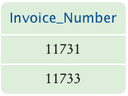
Joins
The information you want may be spread over multiple tables
TableName.ColumnName denotes the column in a particular table
  Use Product.Product_Code to specify the Product_Code column in the Product table
  Use LineItem.Product_Code to specify the Product_Code column in the LineItem table
To select all invoices that include a car vacuum:
  SELECT LineItem.Invoice_Number
  FROM Product, LineItem
  WHERE Product.Description = 'Car vacuum’
  AND Product.Product_Code = LineItem.Product_Code

Slide 32
Joins
A query that involves multiple tables is a join
When using a join, do these things
  List all tables that are involved in the query in the FROM clause
  Use the TableName.ColumnName syntax to refer to column names
  List all join conditions in the WHERE clause
  (TableName1.ColumnName1 = TableName2.ColumnName2)

Slide 33

Joins
You may want to know in what cities hair dryers are popular
You need to add the Customer table to the query – it contains the customer addresses
Customers are referenced by invoices, add that table as well:
  SELECT Customer.City, Customer.State, Customer.Zip
  FROM Product, LineItem, Invoice, Customer
  WHERE Product.Description = 'Hair dryer'
  AND Product.Product_Code = LineItem.Product_Code
  AND LineItem.Invoice_Number =
  Invoice.Invoice_Number
  AND Invoice.Customer_Number =
  Customer.Customer_Number

Slide 34
Updating and Deleting Data
The DELETE and UPDATE commands modify the database
The DELETE command deletes rows
To delete all customers in California:
  DELETE FROM Customer WHERE State = 'CA'

Slide 35
Updating and Deleting Data
The UPDATE query lets you update columns of all records that fulfill a certain condition
To add one to the quantity of every line item in invoice number 11731:
  UPDATE LineItem
  SET Quantity = Quantity + 1
  WHERE Invoice_Number = '11731'
Update multiple column values by specifying multiple update expressions in the SET clause, separated by commas
Both UPDATE and DELETE return the number of rows updated or deleted

Slide 36
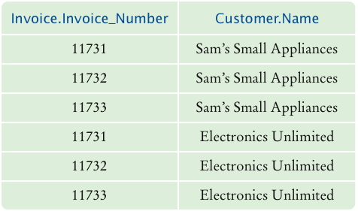
Joining Tables without Specifying a Link Condition
If you select data from multiple tables without a restriction, you get a result set containing all combinations of the values:
  SELECT Invoice.Invoice_Number, Customer.Name
  FROM Invoice, Customer

Slide 37
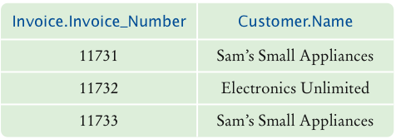
Joining Tables without Specifying a Link Condition
You need to supply a WHERE clause to restrict the set of combinations:
  SELECT Invoice.Invoice_Number, Customer.Name
  FROM Invoice, Customer
  WHERE Invoice.Customer_Number =
  Customer.Customer_Number

Slide 38
JDBC
JDBC: Java Database Connectivity
You need a JDBC driver to access a database from a Java program
Different databases require different drivers
Drivers may be supplied by the database manufacturer or a third party
When your Java program issues SQL commands, the driver forwards them to the database and lets your program analyze the results

Slide 39
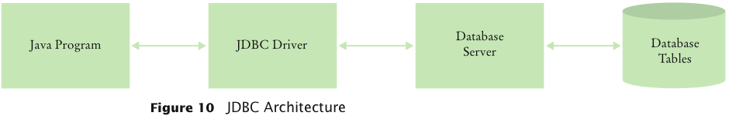
JDBC Architecture

Slide 40
Installing a Database
A wide variety of database systems are available. Among them are
  High-performance commercial databases, such as Oracle, IBM DB2, or Microsoft SQL Server
  Open-source databases, such as PostgreSQL or MySQL
  Lightweight Java databases, such as Apache Derby
  Desktop databases, such as Microsoft Access

Slide 41
Apache Derby
Included in Java 6
  With earlier versions of Java, download Apache Derby
Test with program TestDB:
  Locate the JDBC driver file derby.jar and copy it into the ch22/test directory of the companion code for this book
  Open a command shell, change to the ch22/test directory, and run
  javac TestDB.java
  java -classpath derby.jar;. TestDB database.properties
  If you see one line of output with the name “Romeo”, then Apache Derby is properly installed

Slide 42
Installing a Database
Detailed instructions for installing a database vary widely
General sequence of steps on how to install a database and test your installation:
  Install the database program
  Start the database
  Set up user accounts
  Run a test:
  CREATE TABLE Test (Name CHAR(20))
  INSERT INTO Test VALUES ('Romeo')
  SELECT * FROM Test
  DROP TABLE Test
  Note that you may need a special terminator for each SQL statement (e.g. ';')

Slide 43
Testing the JDBC Driver
Find the class path for the driver, e.g.
  c:\jdk1.6.0\db\lib\derby.jar
If your JDBC driver is not fully compliant with the JDBC4 standard, you need to know the name of the driver class, e.g.
  oracle.jdbc.driver.OracleDriver
  Consult your JDBC driver documentation
Find the name of the database URL that your driver expects
  jdbc:subprotocol:driver-specific data
  Examples:
  jdbc:derby:InvoiceDB;create=true jdbc:oracle:thin:@larry.mathcs.sjsu.edu:1521:InvoiceDB

Slide 44
Testing the JDBC Driver
Edit the file database.properties and supply
  The driver class name (if required)
  The database URL
  Your database user name
  Your database password
Compile the program as
  javac TestDB.java
Run the program as
  java -classpath driver_class_path;. TestDB database.properties
or
  java -classpath driver_class_path:. TestDB database.properties

Slide 45
Testing the JDBC Driver: Possible Problems
Missing driver
  Check the class path and the driver name
Driver cannot connect to the database
  The database may not be started
  Database may not be reachable
Failed login
  Check the database name, user name, and password
A missing Test table
  Make sure you create and populate the table as described in the database test

Slide 46
ch22/test/TestDB.java
1 import java.io.File;
2 import java.sql.Connection;
3 import java.sql.ResultSet;
4 import java.sql.Statement;
5
6 /**
7 Tests a database installation by creating and querying
8 a sample table. Call this program as
9 java -classpath driver_class_path;. TestDB database.properties
10 */
11 public class TestDB
12 {
13 public static void main(String[] args) throws Exception
14 {
15 if (args.length == 0)
16 {
17 System.out.println(
18 "Usage: java -classpath driver_class_path"
19 + File.pathSeparator
20 + ". TestDB database.properties");
21 return;
22 }
23 else
24 SimpleDataSource.init(args[0]);
25
Continued

Slide 47
ch22/test/TestDB.java (cont.)
26 Connection conn = SimpleDataSource.getConnection();
27 try
28 {
29 Statement stat = conn.createStatement();
30
31 stat.execute("CREATE TABLE Test (Name CHAR(20))");
32 stat.execute("INSERT INTO Test VALUES (&apos;Romeo&apos;)");
33
34 ResultSet result = stat.executeQuery("SELECT * FROM Test");
35 result.next();
36 System.out.println(result.getString("Name"));
37
38 stat.execute("DROP TABLE Test");
39 }
40 finally
41 {
42 conn.close();
43 }
44 }
45 }

Slide 48
ch22/test/SimpleDataSource.java
1 import java.sql.Connection;
2 import java.sql.DriverManager;
3 import java.sql.SQLException;
4 import java.io.FileInputStream;
5 import java.io.IOException;
6 import java.util.Properties;
7
8 /**
9 A simple data source for getting database connections.
10 */
11 public class SimpleDataSource
12 {
13 private static String url;
14 private static String username;
15 private static String password;
16
Continued

Slide 49
ch22/test/SimpleDataSource.java (cont.)
17 /**
18 Initializes the data source.
19 @param fileName the name of the property file that
20 contains the database driver, URL, username, and password
21 */
22 public static void init(String fileName)
23 throws IOException, ClassNotFoundException
24 {
25 Properties props = new Properties();
26 FileInputStream in = new FileInputStream(fileName);
27 props.load(in);
28
29 String driver = props.getProperty("jdbc.driver");
30 url = props.getProperty("jdbc.url");
31 username = props.getProperty("jdbc.username");
32 if (username == null) username = "";
33 password = props.getProperty("jdbc.password");
34 if (password == null) password = "";
35 if (driver != null)
36 Class.forName(driver);
37 }
38
Continued

Slide 50
ch22/test/SimpleDataSource.java (cont.)
39 /**
40 Gets a connection to the database.
41 @return the database connection
42 */
43 public static Connection getConnection() throws SQLException
44 {
45 return DriverManager.getConnection(url, username, password);
46 }
47 }

Slide 51
ch22/test/database.properties (for Apache Derby)
1: jdbc.url=jdbc:derby:BigJavaDB;create=true
2: # With other databases, you may need to add entries such as these
3: # jdbc.username=admin
4: # jdbc.password=secret
5: # jdbc.driver=org.apache.derby.jdbc.EmbeddedDriver

Slide 52
Database Programming in Java: Connecting to the Database
Use a Connection object to access a database from a Java program
Load the database driver
Ask the DriverManager for a connection
When you are done, close the database connection:
  String driver = ...;
  String url = ...;
  String username = ...;
  String password = ...;
  Class.forName(driver); // Load driver
  Connection conn = DeviceManager.getConnection(url,
  username, password);
  ...
  conn.close();

Slide 53
Connecting to the Database
Decouple connection management from the other database code
We supply a SimpleDataSource class to do this
Call its static init method with the name of the database configuration file:
  SimpleDataSource.init("database.properties");
Configuration file is a text file containing four lines:
  jdbc.driver= ...
  jdbc.url= ...
  jdbc.username= ...
  jdbc.password= ...

Slide 54
Connecting to the Database
The init method uses the Properties class to read the file
Properties class has a load method to read a file of key/value pairs from a stream:
  Properties props = new Properties();
  FileInputStream in = new FileInputStream(fileName);
  props.load(in);
The getProperty method returns the value of a given key:
  String driver = props.getProperty("jdbc.driver");
Now when you need a connection call:
  Connection conn = SimpleDataSource.getConnection();
Close the connection:
  conn.close();

Slide 55
Executing SQL Statements
A Connection object can create Statement objects:
  Statement stat = conn.createStatement();
The execute method of the Statement class executes a SQL statement:
  stat.execute("CREATE TABLE Test (Name VARCHAR(20))");
  stat.execute("INSERT INTO Test VALUES ('Romeo')");
Use executeQuery method of the Statement class to issue a query:
  String query = "SELECT * FROM Test";
  ResultSet result = stat.executeQuery(query);
The result of a SQL query is returned in a ResultSet object

Slide 56
Executing SQL Statements
Use the executeUpdate method of the Statement class to execute an UPDATE statement
The method returns the number of rows effected:
  String command = "UPDATE LineItem"
  + " SET Quantity = Quantity + 1"
  + " WHERE Invoice_Number = '11731'";
  int count = stat.executeUpdate(command);

Slide 57
Executing SQL Statements
If your statement has variable parts, use a PreparedStatement:
  String query = "SELECT * WHERE Account_Number = ?";
  PreparedStatement stat = conn.prepareStatement(query);
The ? symbols denote variables that you fill in when you make an actual query
Call a set method to fill this variables:
  stat.setString(1, accountNumber);
The first parameter the set methods denotes the variable position (1 is the first ?)
There are also methods setInt and setDouble
After setting all variables, call executeQuery or executeUpdate

Slide 58
Executing SQL Statements
You can also use a generic execute statement to execute queries
It returns a boolean value to indicate whether SQL command yields a result set
If there is a result set, get it with the getResultSet method

Slide 59
Executing SQL Statements
Otherwise, get the update count with the getUpdateCount method:
  String command = ... ;
  boolean hasResultSet = stat.execute(command);
  if (hasResultSet)
  {
  ResultSet result = stat.getResultSet();
  ...
  {
  else
  {
  int count = stat.getUpdateCount();
  ...
  }

Slide 60
Executing SQL Statements
You can reuse a Statement or PreparedStatement object
For each statement, you should only have one active ResultSet
If you need to look at multiple result sets at the same time, create multiple Statement objects
Close the current ResultSet before issuing a new query on the same statement:
  result.close();
When you are done with a Statement object, close it:
  stat.close();
  That will also close the ResultSet

Slide 61
Analyzing Query Results
Use the next method of the ResultSet to iterate through the query results a row at a time
When a result set is first returned from an executeQuery, no row data are available
Use the next method to move to the first row
The next method returns a boolean value indicating whether more rows of data are available:
  while (result.next())
  {
  Inspect column data from the current row
  }

Slide 62
Analyzing Query Results
To get the column values from a row, use one of the various get methods
There are two get methods for each type of data (string, integer, double ...)
Use an integer parameter that indicates the column position
Column positions start at 1:
  String productCode = result.getString(1);

Slide 63
Analyzing Query Results
The other type of get method uses a string parameter for the column name:
  String productCode = result.getString("Product_Code");
Use getInt to fetch an integer column value:
  int quantity = result.getInt("Quantity");
Use getDouble to fetch an double column:
  value double unitPrice = result.getDouble("Price");

Slide 64
ResultSetMeta Data
Result set meta data describes the properties of the result set
Use the ResultSetMetaData class to find out the column names in an unknown table
Get the meta data object from the result set:
  ResultSetMetaData metaData = result.getMetaData();

Slide 65
Result Set Meta Data
Use getColumnCount method to get the number of columns
Use getColumnLabel method to get the name of each column
Use getColumnDisplaySize method to get the column width:
  for (int i = 1; i <= metaData.getColumnCount(); i++)
  {
  String columnName = metaData.getColumnLabel(i);
  int columnSize = metaData.getColumnDisplaySize(i);
  ...
  }

Slide 66
Result Set Meta Data
The following program reads a file containing SQL statements and executes them
If there is a result set, the result set is printed
Meta data from the result set is used to determine the column count and column label
Run the program as:
  java -classpath derby.sql;. ExecSQL database.properties Product.sql
Or interactively as:
  java -classpath derby.sql;. ExecSQL database.properties

Slide 67
ch22/exec/Product.sql
1: CREATE TABLE Product (Product_Code CHAR(10), Description CHAR(40), Price DECIMAL(10, 2))
2: INSERT INTO Product VALUES ('116-064', 'Toaster', 24.95)
3: INSERT INTO Product VALUES ('257-535', 'Hair dryer', 29.95)
4: INSERT INTO Product VALUES ('643-119', 'Car vacuum', 19.95)
5: SELECT * FROM Product

Slide 68
ch22/exec/ExecSQL.java
1 import java.sql.Connection;
2 import java.sql.ResultSet;
3 import java.sql.ResultSetMetaData;
4 import java.sql.Statement;
5 import java.sql.SQLException;
6 import java.io.File;
7 import java.io.IOException;
8 import java.util.Scanner;
9
10 /**
11 Executes all SQL statements from a file or the console.
12 */
13 public class ExecSQL
14 {
15 public static void main(String[] args)
16 throws SQLException, IOException, ClassNotFoundException
17 {
Continued

Slide 69
ch22/exec/ExecSQL.java (cont.)
18 if (args.length == 0)
19 {
20 System.out.println(
21 "Usage: java -classpath driver_class_path"
22 + File.pathSeparator
23 + ". ExecSQL propertiesFile [SQLcommandFile]");
24 return;
25 }
26
27 SimpleDataSource.init(args[0]);
28
29 Scanner in;
30 if (args.length > 1)
31 in = new Scanner(new File(args[1]));
32 else
33 in = new Scanner(System.in);
34
35 Connection conn = SimpleDataSource.getConnection();
Continued

Slide 70
ch22/exec/ExecSQL.java (cont.)
36 try
37 {
38 Statement stat = conn.createStatement();
39 while (in.hasNextLine())
40 {
41 String line = in.nextLine();
42 try
43 {
44 boolean hasResultSet = stat.execute(line);
45 if (hasResultSet)
46 {
47 ResultSet result = stat.getResultSet();
48 showResultSet(result);
49 result.close();
50 }
51 }
52 catch (SQLException ex)
53 {
54 System.out.println(ex);
55 }
56 }
57 }
58 finally
59 {
60 conn.close();
61 }
62 }
63
Continued

Slide 71
ch22/exec/ExecSQL.java (cont.)
64 /**
65 Prints a result set.
66 @param result the result set
67 */
68 public static void showResultSet(ResultSet result)
69 throws SQLException
70 {
71 ResultSetMetaData metaData = result.getMetaData();
72 int columnCount = metaData.getColumnCount();
73
74 for (int i = 1; i <= columnCount; i++)
75 {
76 if (i > 1) System.out.print(", ");
77 System.out.print(metaData.getColumnLabel(i));
78 }
79 System.out.println();
80
81 while (result.next())
82 {
83 for (int i = 1; i <= columnCount; i++)
84 {
85 if (i > 1) System.out.print(", ");
86 System.out.print(result.getString(i));
87 }
88 System.out.println();
89 }
90 }
91 }

Slide 72
Case Study: A Bank Database
This is a reimplementation of the ATM simulation
In the simulation each customer has:
  A customer number
  A PIN
  A checking account
  A savings account
The data will be stored in two tables in a database

Slide 73
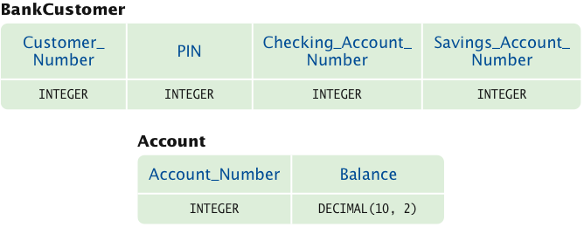
Tables for ATMSimulation

Slide 74
Case Study: A Bank Database
The Bank class needs to connect to the database whenever it is asked to find a customer
Its findCustomer method
  Connects to the database
  Selects the customer with the given account number:
    SELECT * FROM BankCustomer WHERE Customer_Number = ...
  Verifies the PIN
  Creates an customer object from the database information

Slide 75
Case Study: A Bank Database
public Customer findCustomer(int customerNumber, int pin)
throws SQLException
{
Connection conn = SimpleDataSource.getConnection();
try
{
Customer c = null;
PreparedStatement stat = conn.prepareStatement(
"SELECT * FROM BankCustomer WHERE Customer_Number
= ?");
stat.setInt(1, customerNumber);
ResultSet result = stat.executeQuery();
if (result.next() && pin == result.getInt("PIN"))
c = new Customer(customerNumber,
result.getInt("Checking_Account_Number"),
result.getInt("Savings_Account_Number"));
return c;
}
Continued

Slide 76
Case Study: A Bank Database (cont.)
finally
{
conn.close();
}
}

Slide 77
Case Study: A Bank Database
The BankAccount methods are different now
The getBalance method gets the balance from the database
The withdraw and deposit methods update the database immediately

Slide 78
Case Study: A Bank Database
public double getBalance()
throws SQLException
{
Connection conn = SimpleDataSource.getConnection();
try
{
double balance = 0;
PreparedStatement stat = conn.prepareStatement(
"SELECT Balance FROM Account WHERE Account_Number
= ?");
stat.setInt(1, accountNumber);
ResultSet result = stat.executeQuery();
if (result.next())
balance = result.getDouble(1);
return balance;
}
Continued

Slide 79
Case Study: A Bank Database (cont.)
finally
{
conn.close();
}
}

Slide 80
Case Study: A Bank Database
public void deposit(double amount)
throws SQLException
{
Connection conn = SimpleDataSource.getConnection();
try
{
PreparedStatement stat = conn.prepareStatement(
"UPDATE Account"
+ " SET Balance = Balance + ?"
+ " WHERE Account_Number = ?");
stat.setDouble(1, amount);
stat.setInt(2, accountNumber);
stat.executeUpdate();
}
finally
{
conn.close();
}
}

Slide 81
ch22/atm/Bank.java
1 import java.sql.Connection;
2 import java.sql.ResultSet;
3 import java.sql.PreparedStatement;
4 import java.sql.SQLException;
5
6 /**
7 A bank consisting of multiple bank accounts.
8 */
9 public class Bank
10 {
11 /**
12 Finds a customer with a given number and PIN.
13 @param customerNumber the customer number
14 @param pin the personal identification number
15 @return the matching customer, or null if none found
16 */
17 public Customer findCustomer(int customerNumber, int pin)
18 throws SQLException
19 {
20 Connection conn = SimpleDataSource.getConnection();
Continued

Slide 82
ch22/atm/Bank.java (cont.)
21 try
22 {
23 Customer c = null;
24 PreparedStatement stat = conn.prepareStatement(
25 "SELECT * FROM BankCustomer WHERE Customer_Number = ?");
26 stat.setInt(1, customerNumber);
27
28 ResultSet result = stat.executeQuery();
29 if (result.next() && pin == result.getInt("PIN"))
30 c = new Customer(customerNumber,
31 result.getInt("Checking_Account_Number"),
32 result.getInt("Savings_Account_Number"));
33 return c;
34 }
35 finally
36 {
37 conn.close();
38 }
39 }
40 }

Slide 83
ch22/atm/BankAccount.java
1 import java.sql.Connection;
2 import java.sql.ResultSet;
3 import java.sql.PreparedStatement;
4 import java.sql.SQLException;
5
6 /**
7 A bank account has a balance that can be changed by
8 deposits and withdrawals.
9 */
10 public class BankAccount
11 {
12 private int accountNumber;
13
14 /**
15 Constructs a bank account with a given balance.
16 @param anAccountNumber the account number
17 */
18 public BankAccount(int anAccountNumber)
19 {
20 accountNumber = anAccountNumber;
21 }
22
Continued

Slide 84
ch22/atm/BankAccount.java (cont.)
23 /**
24 Deposits money into a bank account.
25 @param amount the amount to deposit
26 */
27 public void deposit(double amount)
28 throws SQLException
29 {
30 Connection conn = SimpleDataSource.getConnection();
31 try
32 {
33 PreparedStatement stat = conn.prepareStatement(
34 "UPDATE Account"
35 + " SET Balance = Balance + ?"
36 + " WHERE Account_Number = ?");
37 stat.setDouble(1, amount);
38 stat.setInt(2, accountNumber);
39 stat.executeUpdate();
40 }
41 finally
42 {
43 conn.close();
44 }
45 }
46
Continued

Slide 85
ch22/atm/BankAccount.java (cont.)
47 /**
48 Withdraws money from a bank account.
49 @param amount the amount to withdraw
50 */
51 public void withdraw(double amount)
52 throws SQLException
53 {
54 Connection conn = SimpleDataSource.getConnection();
55 try
56 {
57 PreparedStatement stat = conn.prepareStatement(
58 "UPDATE Account"
59 + " SET Balance = Balance - ?"
60 + " WHERE Account_Number = ?");
61 stat.setDouble(1, amount);
62 stat.setInt(2, accountNumber);
63 stat.executeUpdate();
64 }
65 finally
66 {
67 conn.close();
68 }
69 }
70
Continued

Slide 86
ch22/atm/BankAccount.java (cont.)
71 /**
72 Gets the balance of a bank account.
73 @return the account balance
74 */
75 public double getBalance()
76 throws SQLException
77 {
78 Connection conn = SimpleDataSource.getConnection();
79 try
80 {
81 double balance = 0;
82 PreparedStatement stat = conn.prepareStatement(
83 "SELECT Balance FROM Account WHERE Account_Number = ?");
84 stat.setInt(1, accountNumber);
85 ResultSet result = stat.executeQuery();
86 if (result.next())
87 balance = result.getDouble(1);
88 return balance;
89 }
90 finally
91 {
92 conn.close();
93 }
94 }
95 }

